Slide 1
Object Oriented Programming using Java (ECSE102L)

Slide 2
Outline
Data Type
Variable
Variable Name
Operators
Precedence of Operators
Examples of Operators

Slide 3
Data Type
S
There are mainly two types of data type:
    Primitive: Byte, short, int, long, float, double, boolean and char
    Non-primitive: String, arrays and classes

Slide 4
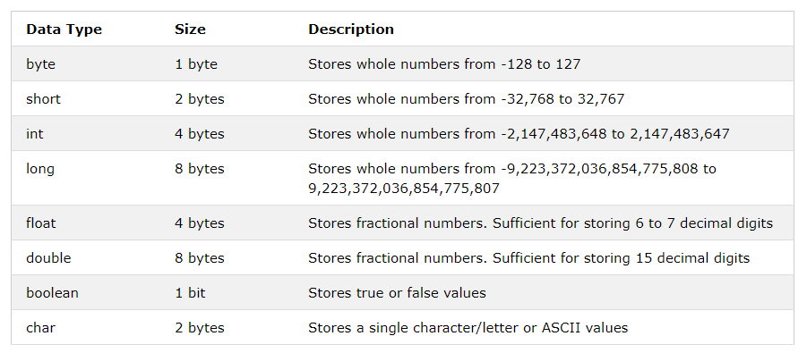
Data Type (Cont…)
S

Slide 5
Variable
S
A variables can be considered as a name given to the location in memory where values are stored.
  <datatype> <variable_name>
Can the value of variable be changed?
  Yes

Slide 6
Variable Name
S
Use only the characters ‘a’ through ‘z’, ‘A’ through ‘Z, ‘0’ through ‘9’, character ‘_’, and character ‘$’.
A name can’t contain space character.
Do not start with a digit. A name can be of any length.
Case sensitive.
A name can not be a reserved word (A reserved word is a word which has a predefined meaning in Java. Example: int, double, true, etc.).
    Fig 1: JVM architecture

Slide 7
Variable Name (Cont…)
S
Can you answer that whether the below lines are correct or not?
  int good-bye;
  int shrift = 0;
  char thisMustBeTooLong;
  int bubble = 0, toil = 9, trouble = 8
  int 8ball;
  int double;

Slide 8
Variable Name (Cont…)
S
Answers of the last slide:
  int good-bye; //bad variable name
  int shrift = 0; //OK
  char thisMustBeTooLong; //OK in syntax //but poor choice in variable name
  int bubble = 0, toil = 9, trouble = 8 // “;” missing at the end
  int 8ball; //can’t start with a digit
  int double; //double is a reserve word

Slide 9
Operators
S
There are many operators in Java:
  Unary operators
  Arithmetic operators
  Relational operators
  Bitwise operators
  Logical operators
  Assignment operators
  Ternary operators

Slide 10
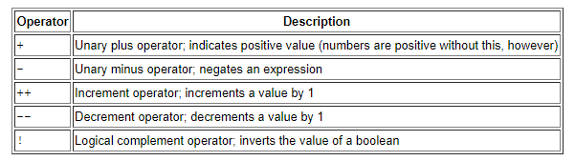
Operators (Cont…)
S
Unary operators:

Slide 11
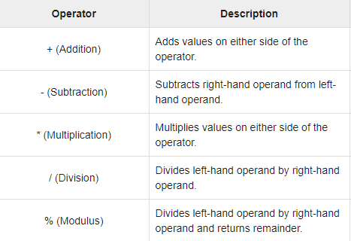
Operators (Cont…)
S
Arithmetic operators:

Slide 12
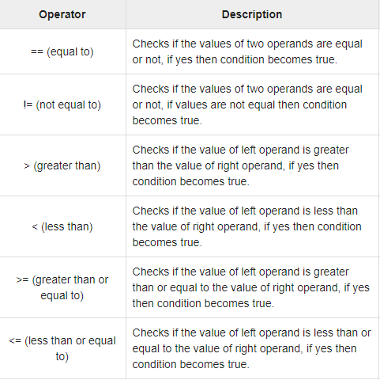
Operators (Cont…)
S
Relational operators:

Slide 13
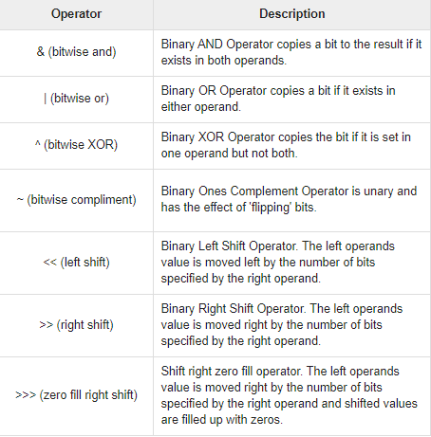
Operators (Cont…)
S
Bitwise operators:

Slide 14
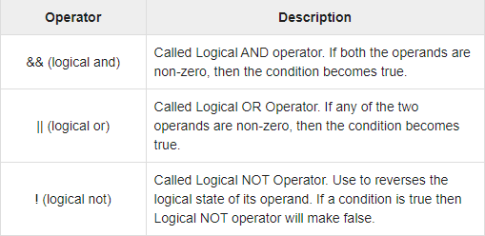
Operators (Cont…)
S
Logical operators:

Slide 15
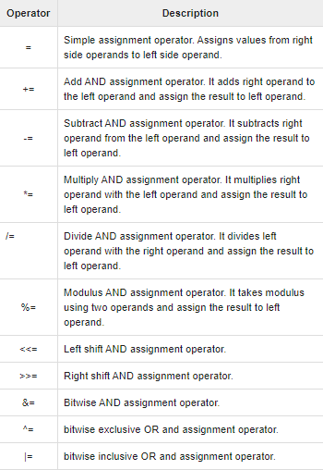
Operators (Cont…)
S
Assignment operators:

Slide 16
Operators (Cont…)
S
  Ternary operators:
    Conditional Operator ( ? : )

Slide 17
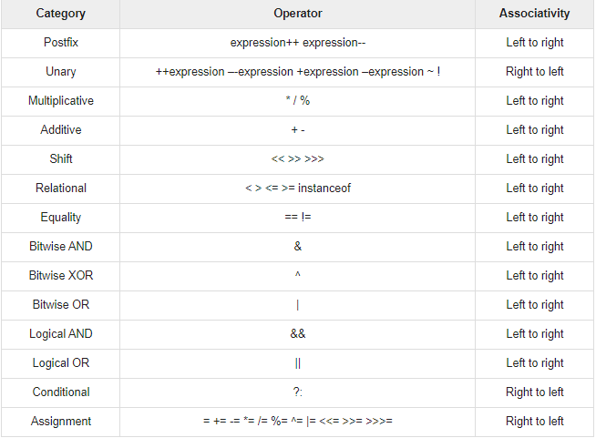
Precedence of the Operators
S

Slide 18
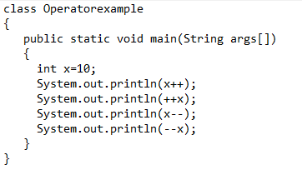
Examples of Operators
S

Slide 19
Examples of Operators
S
Output
  10
  12
  12
  10

Slide 20
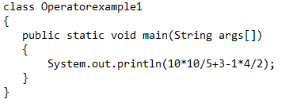
Examples of Operators (Cont…)
S

Slide 21
Examples of Operators (Cont…)
S
Output
  21

Slide 22
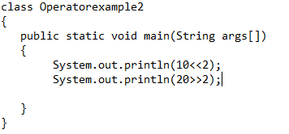
Examples of Operators (Cont…)
S

Slide 23
Examples of Operators (Cont…)
S
Output
  40
  5

Slide 24
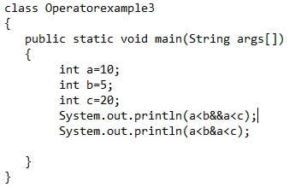
Examples of Operators (Cont…)
S

Slide 25
Examples of Operators (Cont…)
S
Output
  false
  false

Slide 26
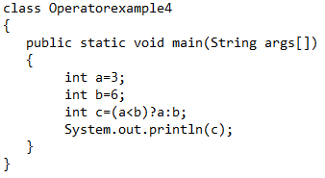
Examples of Operators (Cont…)
S

Slide 27
Examples of Operators (Cont…)
S
Output
  3

Slide 28
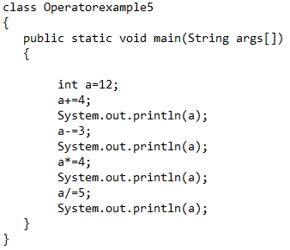
Examples of Operators (Cont…)
S

Slide 29
Examples of Operators (Cont…)
S
Output
  16
  13
  52
  10

Slide 30
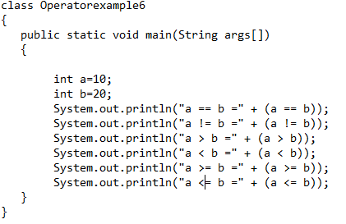
Examples of Operators (Cont…)
S

Slide 31
Examples of Operators (Cont…)
S
Output
  a == b = false
  a != b =true
  a > b =false
  a < b =true
  a >= b =false
  a <= b =true

Slide 32

